Slide 1
Text-Mining: Introduction and theory
The webinar will begin at 1 pm
You now have a menu in the top right corner of your screen.
The red button with a white arrow allows you to expand and contract the webinar menu, in which you can write questions/comments.
Feel free to type questions as we go, we will answer as many as we can at the end
We can’t hear you.
Notes:
Hello everyone.
The webinar starts in 5 minutes.
Hopefully you can all hear me –you are on mute and will stay on mute throughout.
If you want to ask a question you can do so at any time by typing into the questions box at the top right of your screen – press the red arrow if you can’t see it.

Slide 2
Can you hear us?
?
Notes:
You should see a poll on your screen around about now. And if you can answer whether you can hear us or not…
Yes
No

Slide 3
Can you hear us?
If not:
Check your speaker/headset is plugged in / volume is on.
Click on audio to change to listening via phone
We are recording this webinar and will post it on YouTube (https://www.youtube.com/user/UKDATASERVICE)
Notes:
You should see a poll on your screen around about now. And if you can answer whether you can hear us or not…
Yes
No

Slide 4


Text-Mining: Introduction and theory
Dr. J. Kasmire
Research Fellow at Cathie Marsh Institute and UK Data Service
julia.kasmire@manchester.ac.uk
@JKasmireComplex
Notes:
Hello! My name is Dr. Julia Kasmire and my role is to teach computational social science as a New Forms of Data Training on behalf of the UK Data services. Today I will be talking about Text-mining, specifically an introduction to text-mining that focuses on the theory behind structured and unstructured (or semi-unstructured) data and why that matters for learning how to do text-mining and other forms of data-mining.
Before we get into the content today, I just want to double check if you can hear me properly.

Slide 5
You might be interested in...
Recent -
Being a Computational Social Scientist
Web-scraping for Social Science Research (case study, from websites, and from API's)
Code Demos
https://www.ukdataservice.ac.uk/news-and-events/events/past-events.aspx
https://www.youtube.com/user/UKDATASERVICE
Upcoming -
Text-mining: Basic Processes 16 June 20
Text-mining: Advance Options 29 June 20
Health Studies User Conference 30 June 20
Social Data and the Third Sector 2 to 16 July 20
Notes:
So here is a fairly simple example of a research project as it moves through all four steps.
Choices to consider – how to choose the users? Why 20 users? Why 10 days?
Is “by date” precise enough? How about date plus time? What about time zones?
Is trendiness boosted if a hashtag later goes on to trend or must it be trending at the time?
Is an author’s trendiness diluted by volume of tweets that don’t include a trending hashtag or does this show diversity of interests?

Slide 6
You might be interested in...
Recent -
Being a Computational Social Scientist
Web-scraping for Social Science Research (case study, from websites, and from API's)
Code Demos
https://www.ukdataservice.ac.uk/news-and-events/events/past-events.aspx
https://www.youtube.com/user/UKDATASERVICE
Upcoming -
Text-mining: Basic Processes 16 June 20
Text-mining: Advance Options 29 June 20
Health Studies User Conference 30 June 20
Social Data and the Third Sector 2 to 16 July 20
Notes:
So here is a fairly simple example of a research project as it moves through all four steps.
Choices to consider – how to choose the users? Why 20 users? Why 10 days?
Is “by date” precise enough? How about date plus time? What about time zones?
Is trendiness boosted if a hashtag later goes on to trend or must it be trending at the time?
Is an author’s trendiness diluted by volume of tweets that don’t include a trending hashtag or does this show diversity of interests?

Slide 7
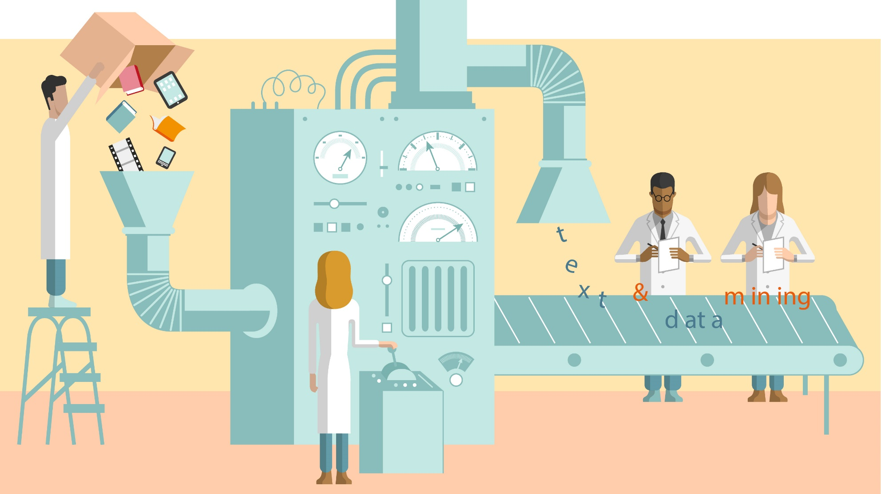
Text-mining is a form of data-mining
Notes:
Text-mining is one kind of data-mining, that (as you might have guessed) looks at text. Other kinds of data-mining might look at images, sounds, movements and many other things.
Importantly, “Data-mining” is not just a buzzword.
CLICK
It is actually a large category of research methods based around the idea of transformation.
Stuff goes in one end
Is transformed
And comes out the other end.
But WHAT exactly is it that goes into the transformation process?
CLICK
Lots of things, including free text writing, speech, videos, images, sound recordings, and lots of other things. Unstructured data can be in chunks, like a blog, or in a stream, like a live video feed.
And what comes out of the transformation process?
CLICK
Data! Specifically, structured data. Let’s talk a bit about that.

Slide 8
What do I mean by structured data?
Intro to Text-Mining
02/06/20
75 attended
Notes:
When people talk about structured data, they mean the kind of data that comes in databases, excel sheets, vectors, arrays or matrices.
The data are arranged in a structured way, usually depicted as columns and rows or as tables.
For example, if I want to track my online education sessions, I would probably want to record basic information like the title of a session I gave…
CLICK
The date I gave it…
CLICK
and the number of attendees.
Now, I could just write this on a like, a sticky note
CLICK
and tack it to my corkboard. That is exactly how some people record information.
But if I can assume that I will be giving LOTS of online education sessions, it is probably safe to assume that I will want to actually do something with the information.
I might want to calculate my average attendance or plot whether my sessions are becoming more or less frequent over time.
Knowing this, it is much more sensible to record the same data for each session in the same place and in the same order.

Slide 9
What do I mean by structured data?
Intro to Text-Mining
02/06/20
75
Text-Mining
Basics
16/06/20
72
Text-Mining Advanced
29/06/20
85
Notes:
So, to do better. I could write the title of my online session
CLICK
And the date I gave it…
CLICK
and the number of attendees (this time just the number).
As structured data.
CLICK
I can do this for each of my online sessions and if I keep the same format then everything in each column
CLICK
Has the same kind of contents. The first column has text
CLICK
The second has dates
CLICK
And the third has only whole numbers, etc. Likewise, the rows are coherent too.
CLICK
So that each item relates in a row relates to the same instance. Sharing this, each item in each row also relates to each other item in the same row.

Slide 10
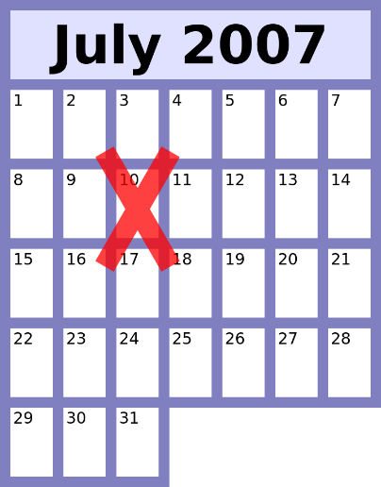
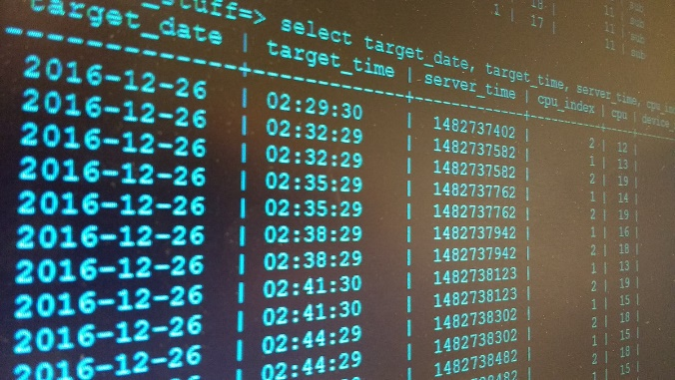
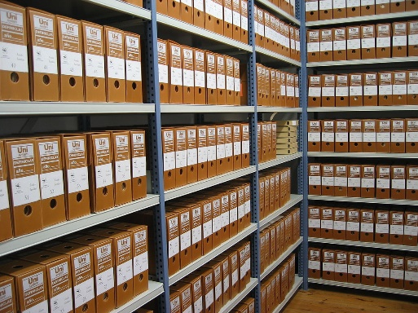




Think about commonly found examples of structured data?
Notes:
There are obvious examples, like
Calendars
Databases
Filing systems
Libraries
Grocery stores?
Clothes in your wardrobe or drawers?
Train stations?

Slide 11

Structured data is…
…familiar
…easy
…demonstrable
Intro to Text-Mining
01/05/20
75
4 steps of Text-Mining
04/06/20
72
Text-Mining analysis
09/07/20
85
Notes:
Great! Now that we have some structured data, we can work with it.
Data scientists have a wealth of experience with structured data. We know how to store it, record it, graph it, do statistical tests on it, show our work and argue about it.
In this example, I could easily runs some basic statistical tests and which lessons was the best attended, or what is my average attendance or whether my online sessions are getting more or less popular over time, or MANY other things.
Importantly, if someone wanted to disagree with my results, they could take my structured data, run their own tests, show me their work and we could discuss it.
CLICK
They like it. It is not exactly clear if they are good at using it because it is easy or if it is easy because they have been using it for so long.

Slide 12

What about unstructured data?
Seventy- two
Intro to Text-Mining 02/06/20
75 attended
Text-mining lesson #2
June 16
2020-06-29
80 - 90
Notes:
Now. UN structured data is familiar to us in our lives, but is much less familiar or easy or demonstrable for data scientists.
CLICK
This actual information content might be about the same but the lack of structure means it is all jumbled up together in one document.
CLICK
Like the note that I originally had pinned to my corkboard and some other notes like it. The info is spread over different notes…
CLICK
With information is a different order or even missing …
CLICK
Like how this one has no title. The information is inconsistent in format
CLICK
Like how the dates are all written differently or
CLICK
how attendance is recorded as numbers plus text, numbers written out as text, or a numerical range with the added complication that one of these (75 attended) includes the value of 75 plus the key, or the word “attended” which tells you what the 75 value relates to, but the others have just the value.
There is also superfluous information, like this picture
CLICK
Of the shoes I want to wear while presenting.

Slide 13
What about semi-unstructured data?
Seventy- two
Intro to Text-Mining 02/06/20
75 attended
Text-mining lesson #2
June 16
2020-06-29
80 - 90
Notes:
The key take away point of looking in detail at this “unstructured data” is that
It is really SEMI-unstructured or even SEMI-structured data.
There is still a lot of structure there, but the structure that is here is much less coherent, ordered, tidy or immediately useful.

Slide 14


Semi-(un)structured data is …
… less accessible
… difficult
… requires intuition and “common sense”
Seventy- two
Intro to Text-Mining 02/06/20
75 attended
Text-mining lesson #2
June 16
2020-06-29
80 - 90
Notes:
So, semi-unstructured or semi-structured data
CLICK
Has items with unique, internal structure but no (or almost no) overall or coherent structure. It has missing values, values measured differently, values labelled differently (or not labelled). It comes in different orders, is spread across sources, and more.
As a consequence, semi-structured data like this just is
CLICK
Familiar to us, on a human level. We interact with semi-structured data like this every time we speak to people. But it is much less familiar or accessible to us as researchers or analysts.
It has information content, but that information is just a whole lot harder and slower to get at it or work with. All the fast tools were developed for structured data and they break down when over-applied. The best option for semi-structured data is just to spend a lot of time with it, reading, understanding, using logic and general knowledge to fill in gaps or retro-actively structured the information. This is, essentially, becoming an expert on a difficult research topic.
Results and conclusions that come out of working with semi-unstructured data rely on a lot of ‘gut instinct’. Whenever two or more people are experts on a difficult, semi-structured data kind of topic, they tend to not agree completely. They have different interpretations, they reach different conclusions and they cannot convince each other because they cannot really show all their work because … really… how do you document how you came to an intuitive conclusion? How do you demonstrate which aspects of your personal life or cultural background colour your interpretation and make one idea seem more or less believable than another?

Slide 15


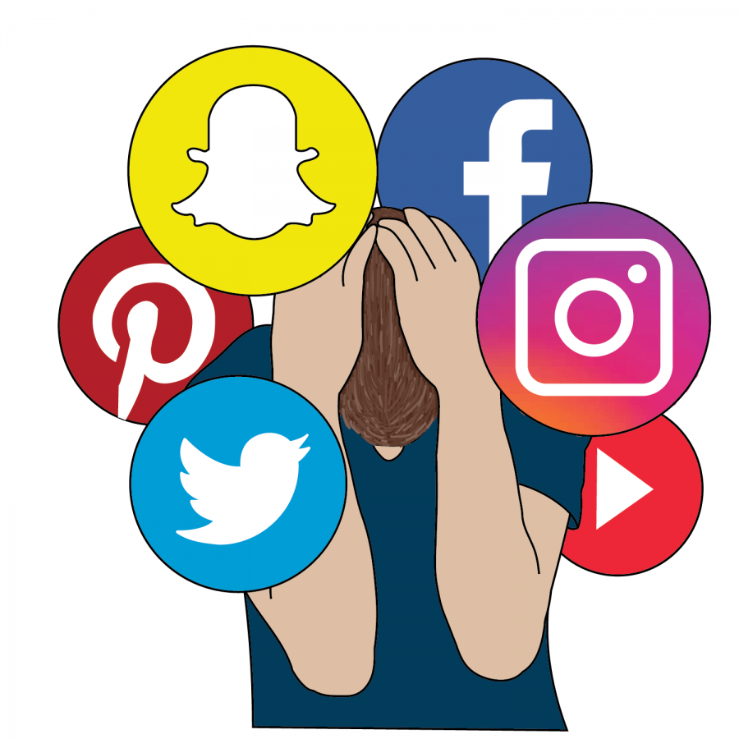
Yeah… and?
Notes:
Traditionally, the differences between structured and unstructured or semi-structured data was just to keep them separate.
CLICK
Science handled the structured stuff and showed all their work, while
CLICK
Humanities and social science did all the less structured stuff and did a lot of writing and talking and discussing about interpretations.
BUT - This division has started to get a bit boring.
We don’t want to limit ourselves in how we approach problems.
We want everyone to show their work as much as possible.
And we realise that semi-structured data is not totally structure-less.
Plus, semi-structured data is growing in volume
CLICK
Way too quickly for someone to become an expert on it in traditional approaches to semi-structured data.
At the same time, semi-structured data is not only more common and more important to our lives, but also more accessible.

Slide 16
Why can’t you just treat semi-structured and structured data the same?
The tools won’t work.
Forcing the tools to “sort of” work can be a real pain and waste of time!
Documenting the process is very difficult which makes for
Poor replicability
Hard to understand methods
Hard to visualise results
First, you need to turn semi-structured data into structured data.
There are tools to help you do that.
Notes:
But, don’t get ahead of yourself! You can’t just apply structured data approaches to semi-structured data right out of the gates.

Slide 17
What are those tools?
Semi-structured data
Structured data
Notes:
Basically, those tools are data-mining, which includes text-mining. These tools turn
CLICK
Semi-structured data into
CLICK
Structured data.
By capturing the structure that already exists within semi-structured data, even if it is irregular and incoherent and only local.
Then, cleaning and amplifying the captured structure to make it suitable for analysis with techniques for structured data.
There are 4 basic steps, which I will take you through now.

Slide 18

Text-mining in four steps
Retrieval
Processing
Extraction
Analysis
SEARCH Source = MANCHESTER EVENING NEWS
Date = 01/01/19700 to 31/12/2019
Keywords = “rail” AND “electrification” AND
“north” AND “England”
Notes:
Step 1, is
CLICK
Retrieval, which is about identifying and acquiring a relevant (and ideally representative) set or subset of text documents.
That might be tweets featuring a certain hashtag, Blog posts with certain keywords, newspaper articles by a particular journalist, the minutes of local council meetings, just about anything.
Let’s say that I want to see if I can identify specific speech patterns that suggest politicians are lying about planned projects.
First, I would retrieve a set of texts that include speech or writing from politicians about projects.
Within this set, at least some of the texts must include known lies, but there should be some about projects that are not yet known to be lies yet.
Your choices depend on your research question and your research resources.
You must balance the desire to get ABSOLUTELY EVERYTHING that might be good to include against the time, computer storage space, processer power, etc. that you have access to.
You have to compromise, but be clear about the choices you make because someone will want you to defend them.
Keep a raw copy of your acquired data. Also, if your data is the result of a search,
CLICK
keep the details of your search including the sources you used, the date range you specified, the search terms, etc.

Slide 19

Text-mining in four steps
Retrieval
Processing
Extraction
Analysis
Raw data - - - > 1 file/row/database entry per tweet/document/webpage
Basic NLP – correct spelling,
remove capitalisation,
substitute acronyms or alternate references
More NLP – classify words by grammatical category,
disambiguate meaning by context,
parse sentences and mark up structure
Notes:
Step 2 is Processing which is a bunch of practical steps that turn your potentially messy raw data into something that…
CLICK
A computer can read.
You can, in theory, do this manually but if you are working with any kind of volume you will want to use computational tools. There are off-the-shelf tools that you can use or adapt, which is likely to require at least a bit of coding in Python or R.
This step includes things like dividing and re-naming files.
But this step also includes Natural Language Processing (NLP) like:
Basic NLP is correcting spelling, removing capital letters, substituting acronyms, etc.
More advance NLP is
classifying words into grammatical categories (e.g., nouns, verbs);
disambiguate words with multiple meanings through context
parse a sentence, which means representing its structure by extracting and marking up text.
This step may be, perhaps surprisingly, one of the most time-consuming steps for a lot of projects.
It requires lot of careful thinking about structure – what you will need for which kind of analysis, how it will be accessed, which things need to be kept separate or put together, how different bits of information relate to each other.
You may need to process the same raw data into multiple processed data sets, each specifically created for a particular analysis.
Even if done well, you may not get 100% perfect results,
If you require perfect or near perfect results, you will need multiple rounds of manual checks and corrections.
If you expect to do these steps on very large volumes of data, or frequently as new data sets become available, you may want to devise your own scripts to automate the processing steps.
That may require much more time at this point, to write the code or manually train a tool, but then you should be able to save time later by using the automated tool.

Slide 20
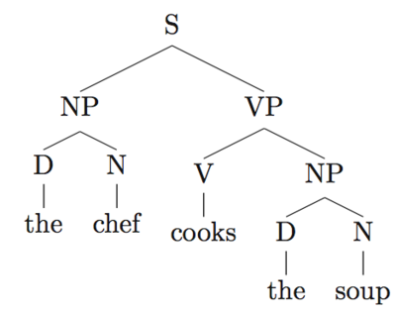
Text-mining in four steps
The chef cooks teh soup.
Retrieval
Processing
Extraction
Analysis
[S: [NP: [D: the] [N:chef]] [VP: [V: cook (singular, present) [NP: [D: the] [N:soup]]]]
Notes:
As an example, let’s say we want to analyse some texts we scraped from internet comment boards.
CLICK
We take this sentence, which we can read easily despite the spelling error…
CLICK
And put it through the NLP process, which are visually represented in these kind of grammar trees, typically with capital letters, punctuation and spelling errors removed. In fact, what comes out of a computational NLM approach is more like … CLICK
This gobbledygook looking output of nested brackets, tag codes and colons. Humans do not find this particularly easy to read, but computers can work with quite well.
Be sure to document all the changes you made here and why.
For example, there is information in the spelling error. Removing that information by correcting the error must be a clear and justified choice relevant to your research question.

Slide 21

Text-mining in four steps
Retrieval
Processing
Extraction
Analysis
(Relative) word counts
Equivalency suggestions
Relationship discovery
Automatic categorisation
Prediction
Notes:
Step 3 is
CLICK
extraction, which is about running a particular statistical method relevant to the original research question.
This might be fairly basic things like
CLICK
relative word frequencies or counts of occurrences of complex multi-word terms. People have used this to show that letters of support written for female and male candidates use statistically different words, thus, potentially gendering some information that should ideally be gender-neutral.
But the methods can also be more complex, such as
CLICK
Identifying whether words used in different contexts are likely to be synonyms or translations of each other. Or
CLICK
Calculating relationships between terms, entities, events, places and more. For example, you could graph the social distance between people or organisations based on how they are or are not mentioned together in documents or you could put events extracted from newspaper articles into timelines or onto maps.
Then, there are lots of kinds of
CLICK
Categorisation, such as classifying documents by sentiment, by topic, by author, time period, gender, etc. These can help recognise plagiarism, or generate automatic responses to customer emails, etc. Finally,
CLICK
Prediction is a growing area of application. Choi & Varian, 2012 call it ‘contemporaneous forecasting’ or ‘nowcasting’ and used it to predict crimes or terror attacks based on intercepted communications.
This step uses familiar statistical analyses to show significant differences or relationships or influences. So, this step is about your regression models, P values, error bars, and so on.

Slide 22
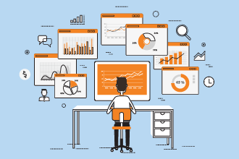
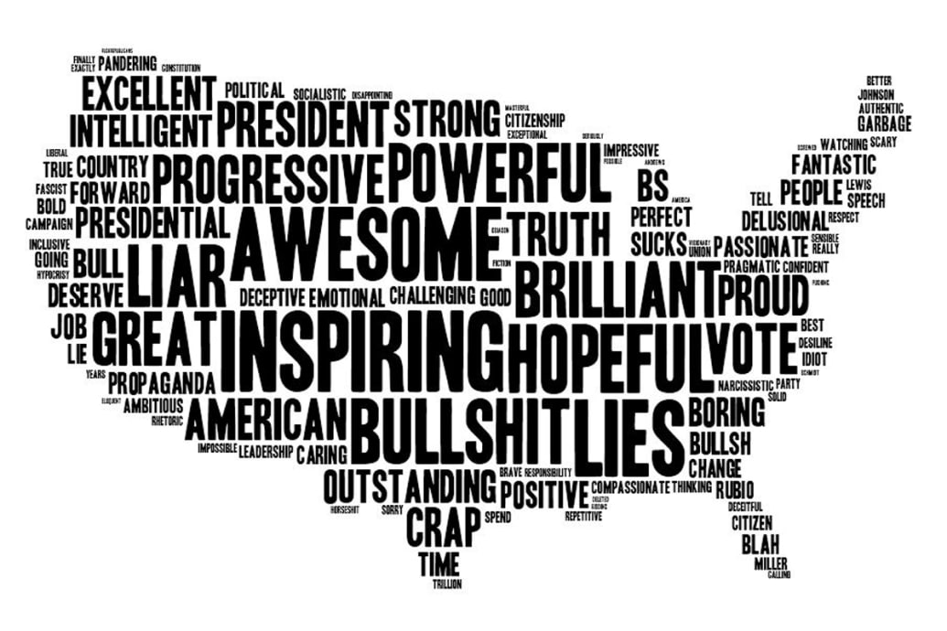
Text-mining in four steps
Retrieval
Processing
Extraction
Insight
Notes:
Step 4 is insight. Like step 3, this should be broadly familiar territory.
This step is about showing my the outcomes from the statistical methods matter. It includes justifying all the steps you took so far –
Why you retrieved what you did,
Why you processed it the way you did,
Why you extracted the things you did and
Why you ran the statistical tests you did.
Many of the hard sciences, and some aspects of social science, do this already. However, it may feel much more exposed than some social scientists are used to.
I have read a lot of papers that say things like “building on the theories of Dr. X, we now add aspects of Y…” which requires that readers buy into the expertise of the writer and their interpretation of the expertise of Dr. X.
Instead, you have to be prepared to specify the exact model, algorithm or code used by Dr. X used and exactly what steps, algorithm, or code you added, changed or re-ordered and why.
This step also includes the presentation or visualisation of the results, which can be difficult when there are not many well accepted examples of how to present or visualise those results well.
For example,
CLICK This is a word cloud of one-word reactions to one of President Obama’s State of the union addresses.
Size represents frequency, but location is irrelevant.
This visualisation has a very different impact than would a simple table with words in one column and frequency counts in the next. But is the difference in impact good? Distracting? Misleading? Simply unfamiliar? Something else?

Slide 23
Text-mining – One simple example
Retrieval Download 10 days of tweets from 20 users.
Download trending hashtags for those same 10 days
Processing Remove everything that isn’t a hashtag (punctuation, trailing whitespace)
Store individual hashtags in data frame labelled by date and author
Extraction Compare tweeted hashtags to trending list – by time, by volume, etc.
Calculate a “trendiness score” for authors based on degree of match and timing
4. Insight Explain what a trendiness score measures –
Influencer status? Finger-on-the-pulse-ness?
Tendency to jump on bandwagons? Something else?
Notes:
So here is a fairly simple example of a research project as it moves through all four steps.
Choices to consider – how to choose the users? Why 20 users? Why 10 days?
Is “by date” precise enough? How about date plus time? What about time zones?
Is trendiness boosted if a hashtag later goes on to trend or must it be trending at the time?
Is an author’s trendiness diluted by volume of tweets that don’t include a trending hashtag or does this show diversity of interests?

Slide 24
Text-mining – A complex example (of mine)
Retrieval Download UK news articles with keywords like “Manchester” AND “commonwealth games”
Processing Articles -> sentences -> tokens -> custom processes that match proper nouns, dates, known structures and relationships, etc.
Extraction Compare extracted and processed tokens to identify events and the temporal relationships between them
Create a timeline of events
Performance score against human analysist and state of the art AI
4. Insight Argue how automated event extraction and time line creation supports policies of event-based investment and regeneration
Notes:
And here is all four steps of a more complex research project, one that I actually contributed to.
Split news articles into individual sentences.
Sentences decomposed into tokens (tagged as part-of-speech (POS), lemma, predicate-argument structures, and any arguments (i.e., subject and object).
Own rules
checking for specific values of POS tags, e.g., to check for verb tense and for modal verbs;
matching lemmatised tokens in look-up lists, e.g., of uncertainty cues, graded adjectives;
checking for definite noun phrases and whether they act as the subject or object of a main verb; and
matching against regular expressions designed to capture absolute and relative temporal expressions.
overall performance of 64\%

Slide 25
Text-mining Pros and Cons
Pros:
Large scale approach to difficult stuff
Can see detail of sub-groups
Novel application
Cons:
Needs a large corpus
May need a lot of manually created training data
Lack of human interaction or supervision
Unclear what questions it can/cannot address
Lops off a bunch of structure or information that is hard to capture/amplify
Notes:
By forcing semi-structured data into structured data, you remove information. For example, standardizing spelling removes the kind of information that we get from recognising that a text has an error or even just a non-standard variant. US vs. UK spelling, for instance, or phat vs. Fat.

Slide 26

Text-mining can’t (yet) provide expert level insight
Notes:
Text-mining, or data-mining more widely, cannot produce the insights and expertise that come with more traditional, human-intensive approaches to semi-structured data.
The thoughtful analysis of a book by an expert critic is not the same as a statistical analysis of how many times each word is used in the book.
It is fine that text-mining cannot provide deep insight, at least not yet although there are some efforts to explore advanced text-mining applications that may not be so far away.

Slide 27
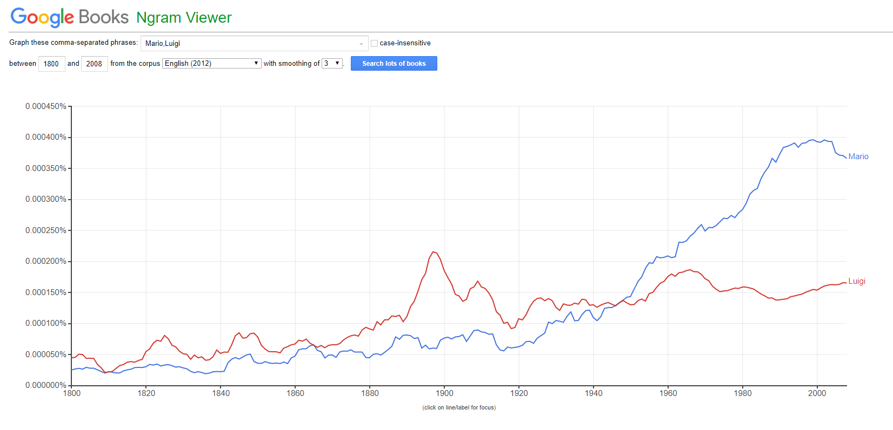
But it text-mining does…
Notes:
Despite not providing all the deep insight we might want from text, text-mining does provide certain kinds of insight that were previously unavailable.
For example, Google Books Ngram viewer is a text-mining application that shows us very quickly that luigi was the more popular name until about 1945 or so, at which point mario became much more popular.
This result is so fast and easy, that we can ask a whole lot of potentially throw away questions like “Which was more popular – Mario or Luigi?”
This fast and easy result does not tell us why this switch happened, why both names used to be fairly close but no longer are, what that spike just before the turn of the 20th century was about.
But the ease and speed with which we can get an answer to a throw away questions means we are much more likely to stumble upon genuinely interesting questions to approach through more detailed investigation, with or without further text-mining tools.
We may also be less likely to waste a whole lot of time on becoming an expert on a topic that seemed promising but which actually turned out to be unimportant.

Slide 28
Citations and recommendations
Cited academic paper
Predicting the Present with Google Trends. Choi and Varian, 2012.
https://doi.org/10.1111/j.1475-4932.2012.00809.x
Recommendations for Python
Programming with Python for Social Scientists. Brooker, 2020.
https://study.sagepub.com/brooker
Automate the Boring Stuff with Python: Practical Programming for Total Beginners, Sweigart, 2019. ISBN-13: 9781593279929
SentDex, python programming tutorials on YouTube https://www.youtube.com/user/sentdex
Recommendations for R
Quanteda, an R package for text analysis https://quanteda.io/
Text Mining with R, a free online book https://www.tidytextmining.com/
Notes:
Despite not providing all the deep insight we might want from text, text-mining does provide certain kinds of insight that were previously unavailable.
For example, Google Books Ngram viewer is a text-mining application that shows us very quickly that luigi was the more popular name until about 1945 or so, at which point mario became much more popular.
This result is so fast and easy, that we can ask a whole lot of potentially throw away questions like “Which was more popular – Mario or Luigi?”
This fast and easy result does not tell us why this switch happened, why both names used to be fairly close but no longer are, what that spike just before the turn of the 20th century was about.
But the ease and speed with which we can get an answer to a throw away questions means we are much more likely to stumble upon genuinely interesting questions to approach through more detailed investigation, with or without further text-mining tools.
We may also be less likely to waste a whole lot of time on becoming an expert on a topic that seemed promising but which actually turned out to be unimportant.

Slide 29


Dr. J. Kasmire
julia.kasmire@manchester.ac.uk
@JKasmireComplex
UKDS
@UKDataService
UKDataService

